Slide 1
MOBILE NETWORK ACCESS DEVICE FOR USE WITH THE DHS ADVANCED CONTAINER SECURITY SYSTEM
Sergio Enriquez

Slide 2
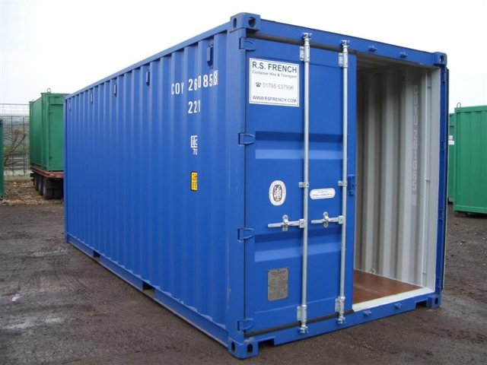

The cargo security problem
Cargo shipments are subject to problems like theft, tampering, used to smuggle contraband.
There is a need for more comprehensive and automated monitoring.
Need for open standards to integrate existing and future security devices as part of centrally controlled program

Slide 3
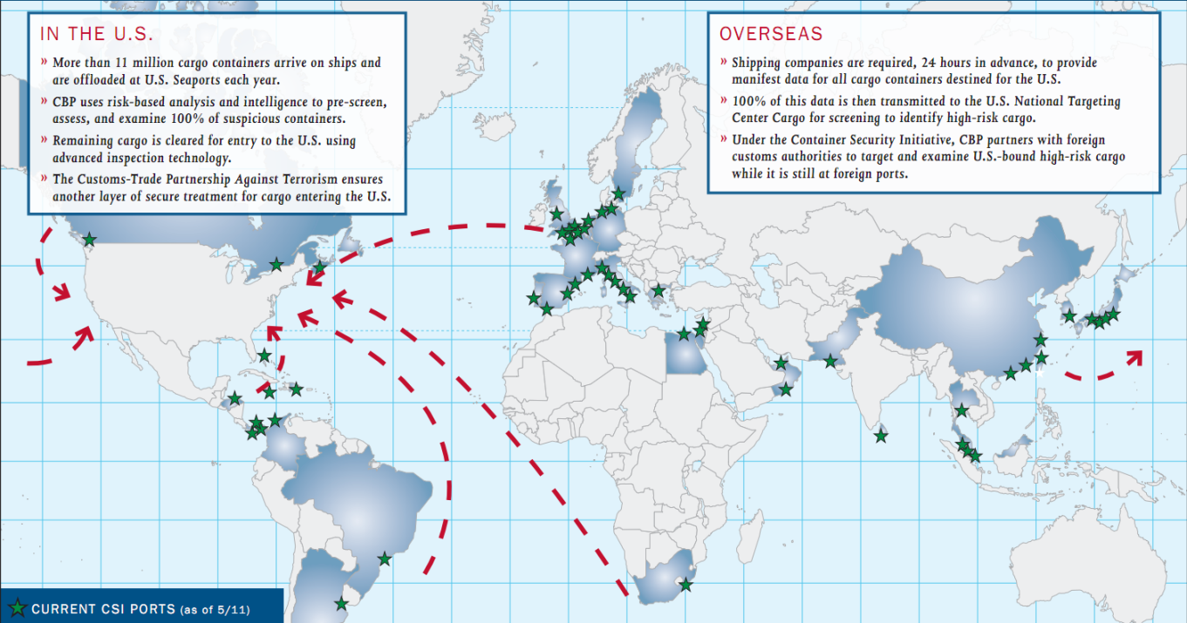
Cargo Security Initiative
Established in 2002 by the US Customs and border Protection agency
CSI works towards improving security of cargo bound for US ports
Goals:
Identify potentially high risk containers
Pre-screen containers before leaving source port
Use technology to ensure rapid screening

Slide 4
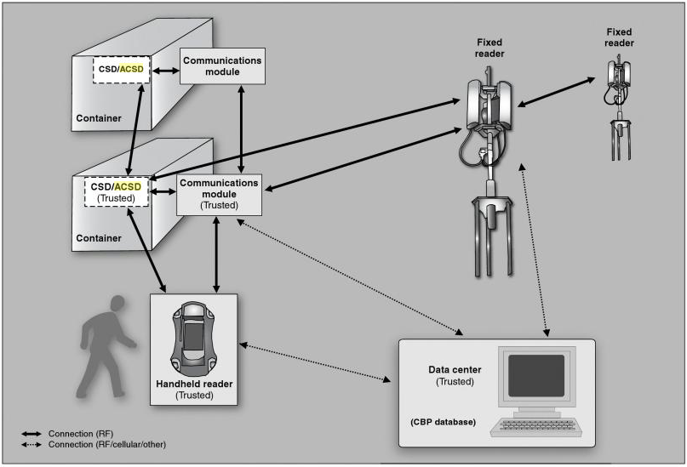
Cargo Security Test Program
Electronic Security Devices (DCP) are mounted on container doors
DCP monitors for tampering, reports wirelessly to Network Access Device (NAD)
NAD units act as bridge between IEEE 802.15.4 WPAN to IP based network
CSTE tasked with establishing open standard defined to allow use of compliant commercially made products

Slide 5
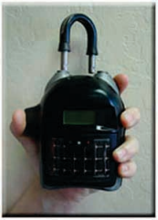
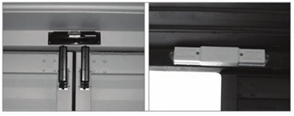
Sample Components
Externally Mounted
Electronic Chain of Custody Device (ECOC)
Internally Mounted:
Container Security Device (CSD)

Slide 6
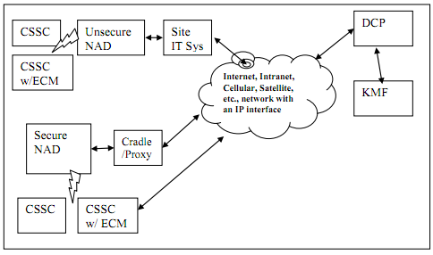
System Components
Cargo Security System Components (CSSC)are attached to cargo
CSSCs communicate with NADs, which forwards status updates to Data Consolidation Point
DCP server provides centralized monitoring of cargo security
Key Management Facility (KMF) server acts as repository for encryption keys system wide

Slide 7
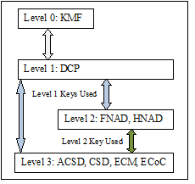
ICD Security Overview
KMF stores and generates new128-bit AES encryption keys for CSD and NAD devices
KMF only communicates with DCP
DCP sends re-key commands to CSD or NADs over IP network
ICD messages encrypted before transmitting over WPAN network, only endpoint device can decrypt

Slide 8
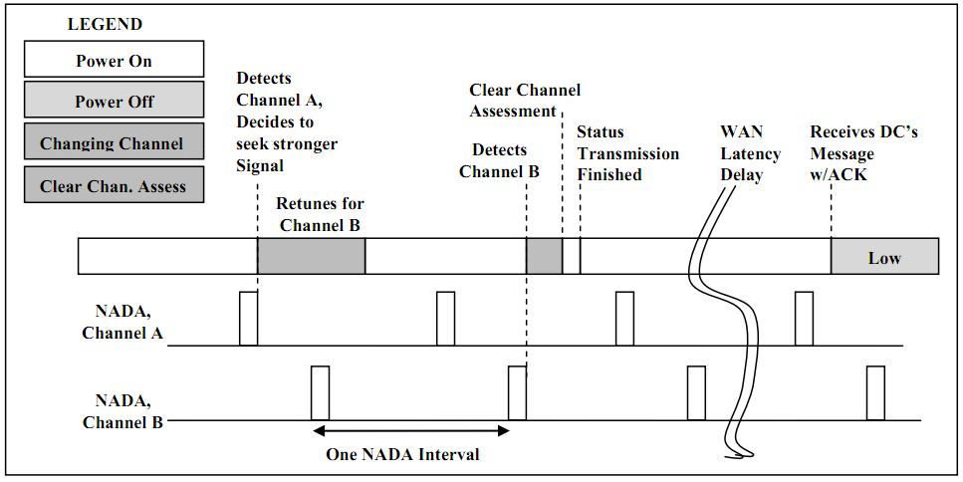
Network Detection
NADs announce presence to CSDs through WPAN network broadcasts
CSDs listen for NADs and associate with the source having best signal strength

Slide 9
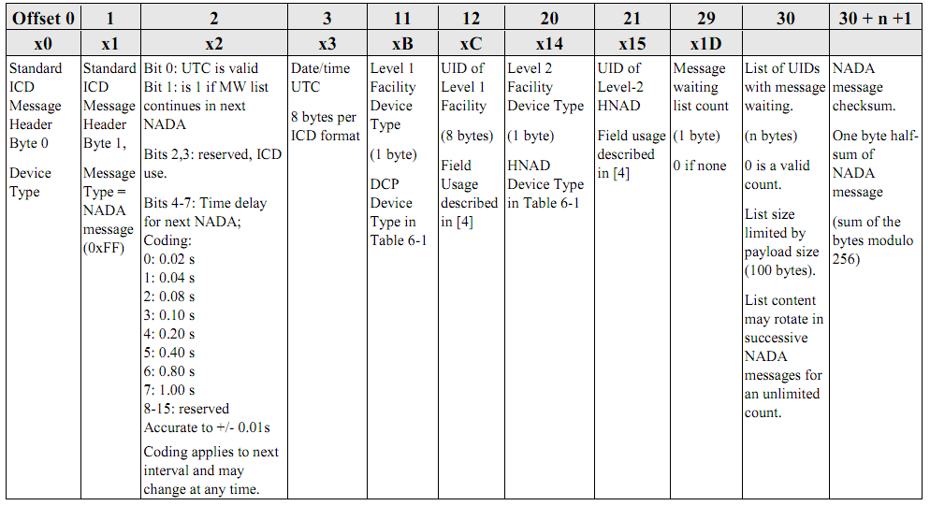
NADA Message
Announcement sent by NADs at regular intervals, used by CSD to know when it has incoming messages

Slide 10
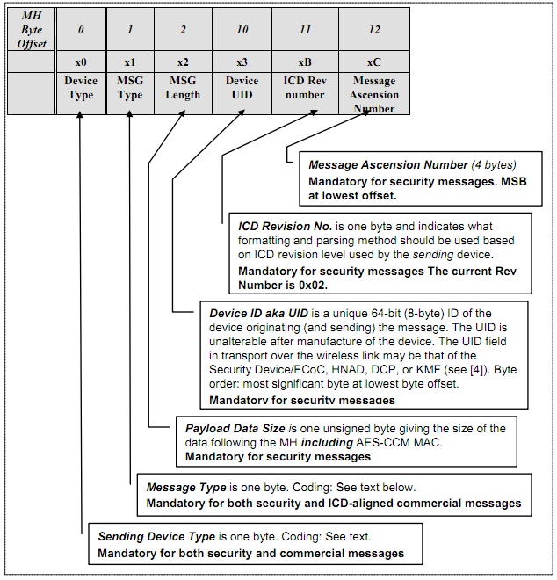
ICD Packet Header
Common header used for ICD security messages and commercial data
Header identifies message source, type, and payload information
Header fields used as the nonce in the payload encryption

Slide 11
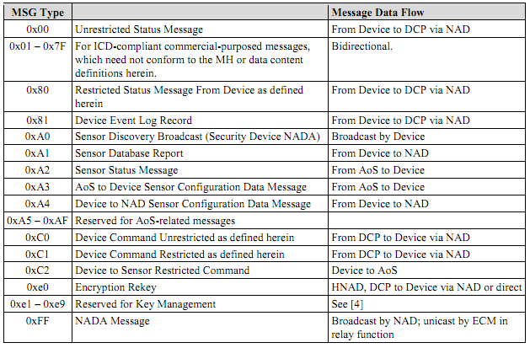
ICD Message Types
1-byte field identifies ICD message types
0x01-0x7F values reserved for commercial messages

Slide 12
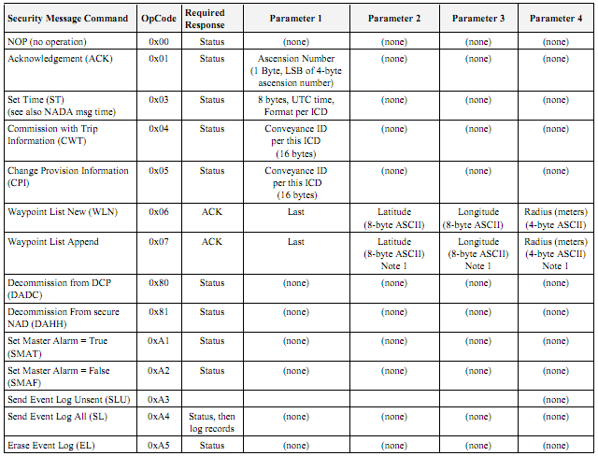
ICD Restricted Commands
Generated by DCP or a secure NAD to control CSD operation or query data status

Slide 13
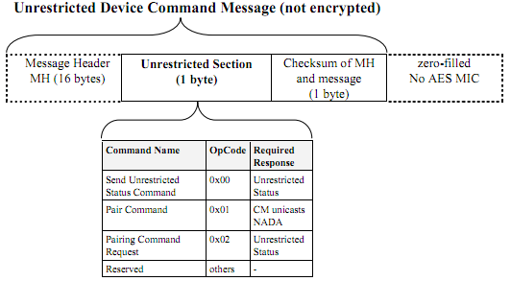
ICD Unrestricted Commands
Sent by an unsecured NAD to request unrestricted status data or begin the CSD sensor pairing process

Slide 14
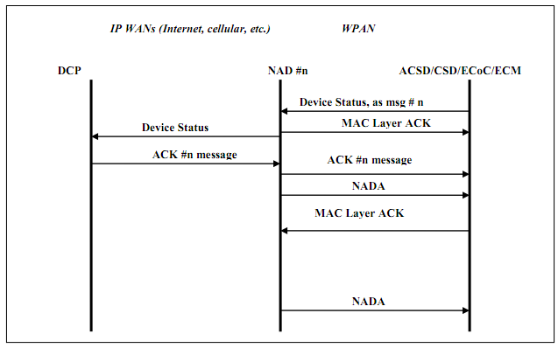
Unrequested Status Message Sequence
Not requested by NAD or DCP
Send by CSD periodically
Recipient is the DCP or secured HNAD

Slide 15
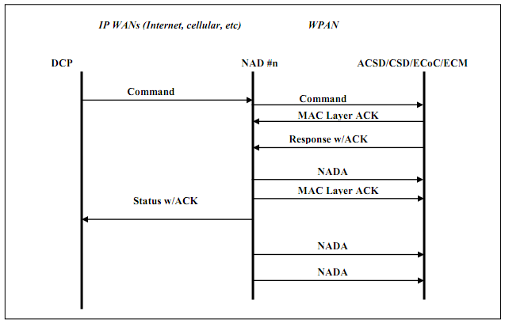
ICD Command Message Sequence
Sent by DCP or secured NAD
CSD sends ACK in the form of a status message

Slide 16
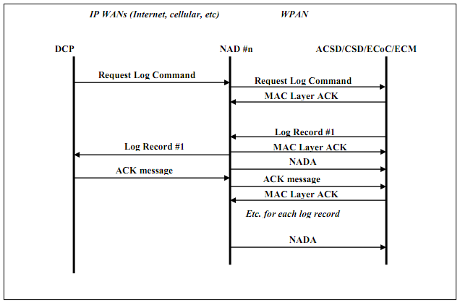
Log Message Sequence
Sent in response to the retrieve logs command
CSD sends one acknowledgement per record

Slide 17
ICD IP Network Communication Overview
Protocol defines protocol for DCP-NAD communications over IP network
Used to forward ICD messages, change network configuration, monitor NAD status
Current ICD IP network specification is expected to change heavily as program evolves

Slide 18
ICD IP Packet Preamble
Preamble identifies the originator of packet and its contents
Function code identifies the currently defined IP message payloads
Field | Size (bytes) | Purpose
Revision | 1 | ICD revision used by source
Function Code | 1 | Identifies the payload type of this message
UID | 8 | Unique ID of the device transmitting this message
Payload | Varies | Content of this message
Code | Type
0 | Heartbeat
1 | Heartbeat Request
2 | ICD Content, DCP to NAD
3 | ICD Content, NAD to DCP
4 | DCP Configuration Change

Slide 19
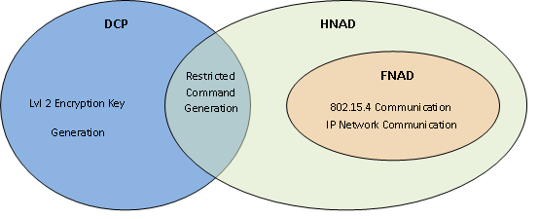
Handheld Network Access Device Functions
Generates restricted commands like DCP
Communicates with DCP over IP network
Keeps temporary access keys for secured CSD communications
Communicates with CSDs over IEEE 802.15.4 WPAN

Slide 20
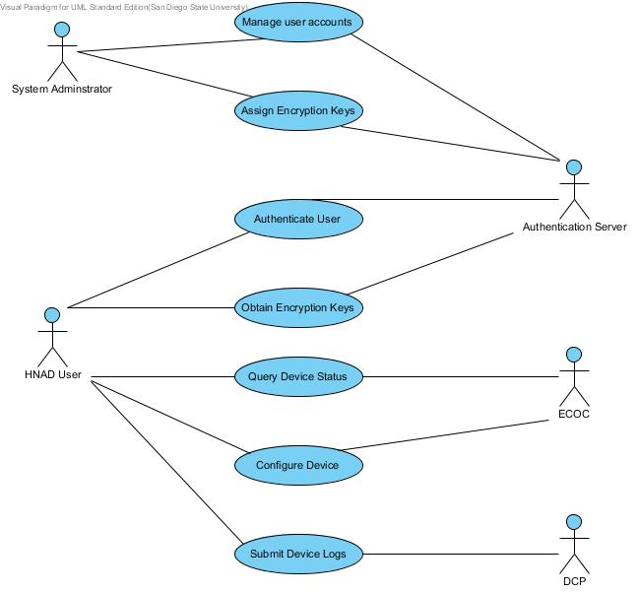
HNAD Use Cases
HNAD user can:
Query CSD status
Request CSD logs
Configure CSD
Arm/Disarm CSD
View/ Clear CSD alarms
Upload HNAD and CSD logs to DCP

Slide 21
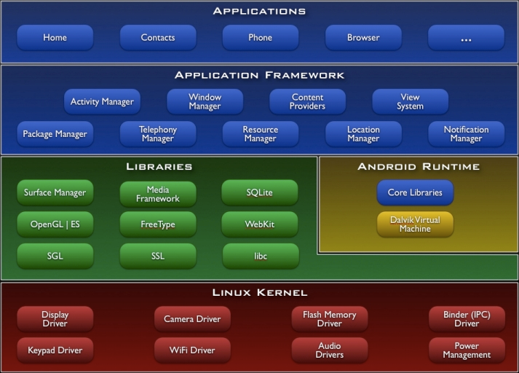
Android OS
OS for handheld devices, based on Linux kernel
Applications use Android API and are compiled to byte code
Applications run on the Dalvik virtual machine

Slide 22
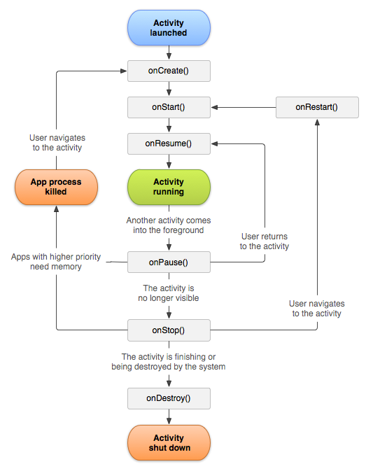
Android Activities
An activity is associated with a particular user screen or task
OS can launch an activity registered to handle a particular intent
OS can suspend and resume activities as required by user interaction

Slide 23
Android Service
Services run in the background and can communicate with registered activities
Communication can be done through object references or system broadcasts
Will continue to run until explicitly ended by an activity
Unsuitable for executing long running tasks, will become unresponsive in this case

Slide 24
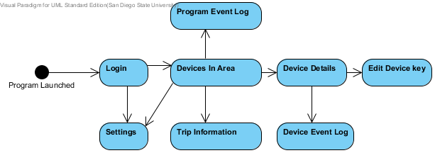
HNAD Activities and Service
HNAD operation is broken into 8 user screens
HNAD service is launched by user or the connection of the USB-XBee bridge device
On launch user will be taken to login screen

Slide 25
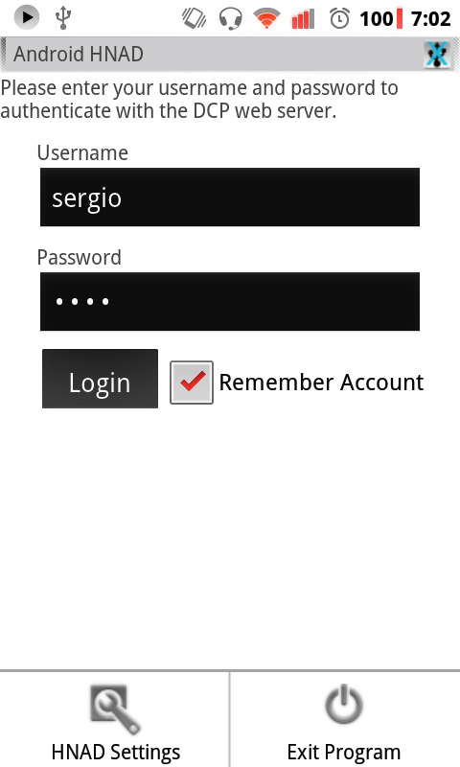
Login Activity
Used to login the user to the authentication server
User needs to only login once to the device if set to remember credentials

Slide 26
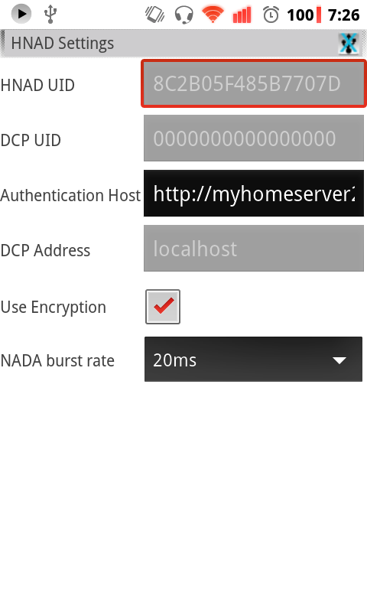
Configuration Activity
Used to configure:
Authentication server address
Enable ICD message encryption
Set network announcement rate

Slide 27
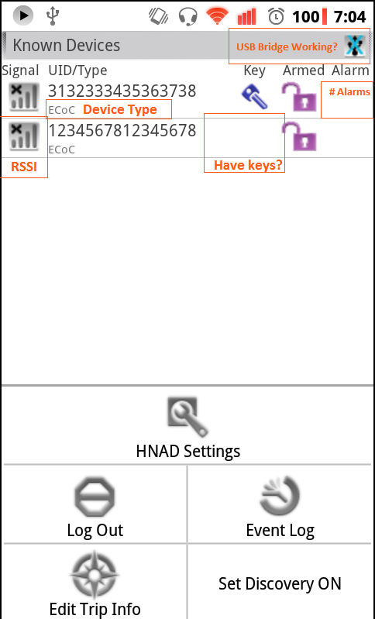
Devices in Area Activity
Displays CSD devices in radio range or those that HNAD possesses keys for
Display status of:
Signal strength
Armed/Disarmed
Have keys
Number of Alarms Triggered

Slide 28
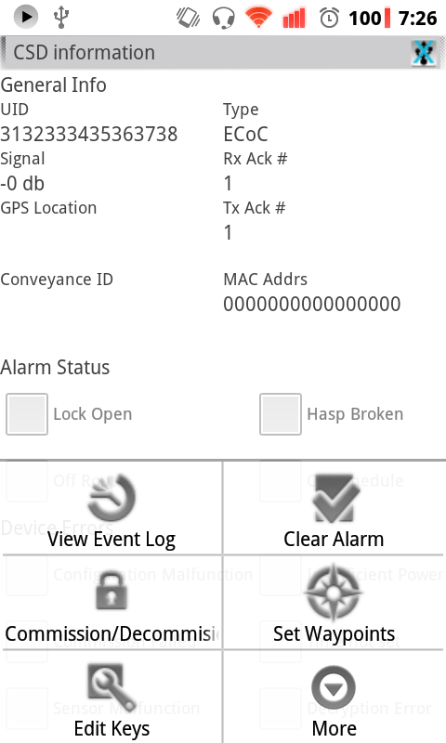
Device Details Activity
Displays detailed device information and status
Data obtained from secured status query
Can send commands to selected device from this screen

Slide 29
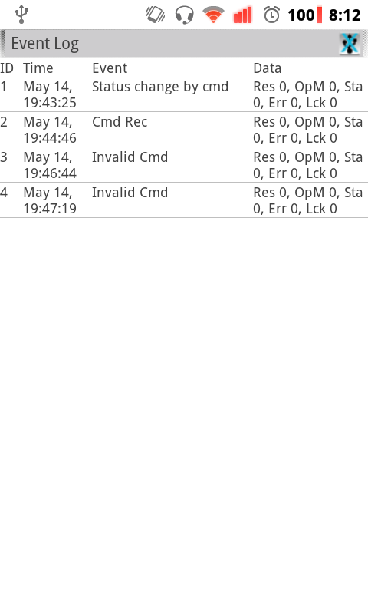
Device Log Activity
Displays event log data collected from selected CSD
Obtained from secured retrieve logs query
Log records stored on local database

Slide 30
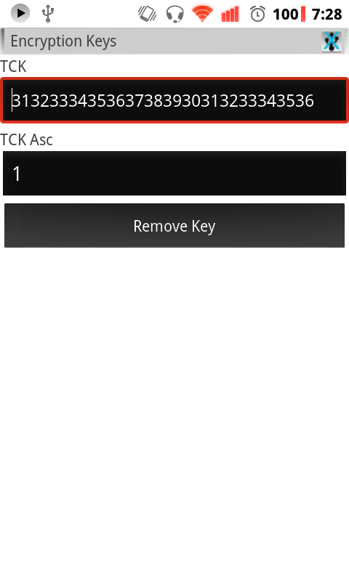
Device Key Edit Activity
Used to
Change the temporary encryption keys used by a device
Change associated ascension number

Slide 31
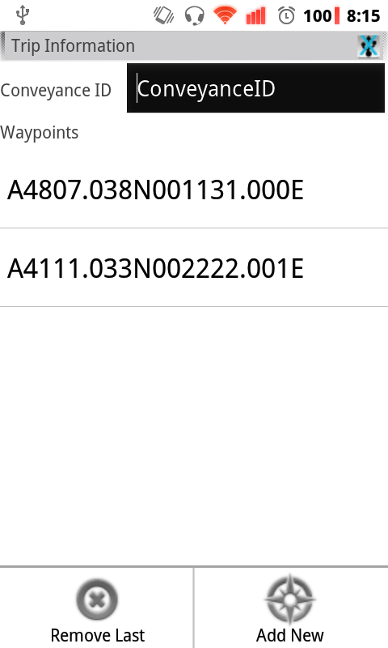
Trip Edit Activity
Used to set the conveyance ID and trip GPS waypoints list
This Data sent to device when it is being commissioned

Slide 32
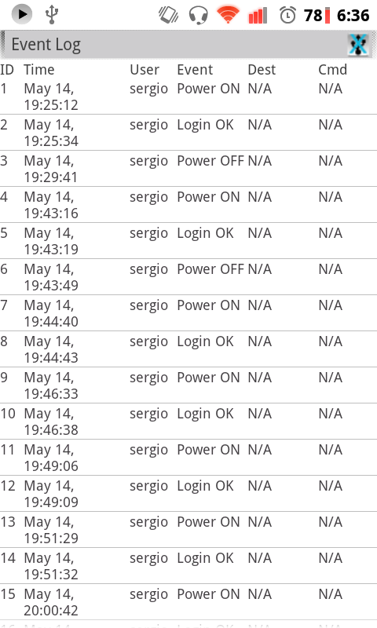
HNAD Log Activity
Displays stored event logs for the HNAD unit
Records created when:
Application launched/closed
User login attempt
ICD message sent
Operational error detected

Slide 33
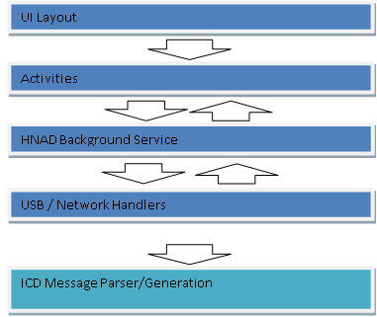
HNAD Application Organization
ICD protocols and requirements expected to change
Application structured to make it easy to change UI and ICD message parsing/generation

Slide 34
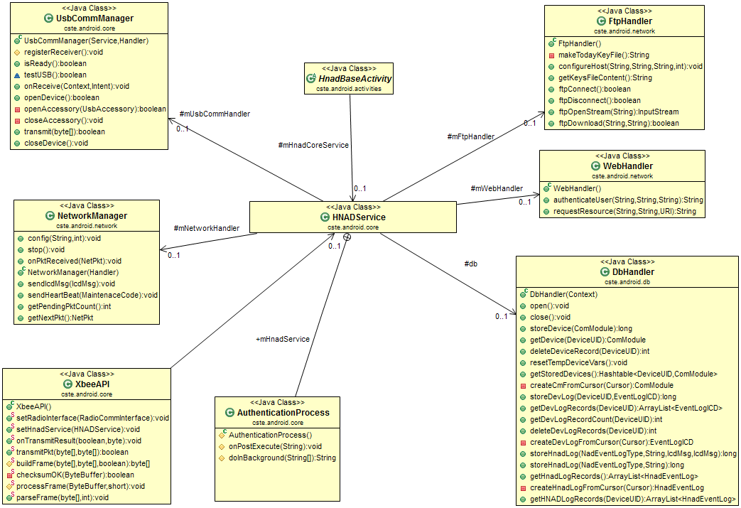
HNAD Service Components

Slide 35
HNAD Event Broadcast Updates
Sent by HNAD service to trigger UI update
Broadcast type | Purpose | Payload
DEVICE_INFO_CHANGED | The status or some member variable of a device has changed due to the arrival of an external message | UID of affected device
DEVLIST_CHANGED | A new device is visible, or its record has been deleted from memory. | UID of new/removed device
LOGIN_RESULT | Result of an authentication attempt | Boolean
UPLOAD_DATA | Result of submitting data to the DCP over the internet | Boolean
USB_STATE_CHANGED | USB accessory has been disconnected/ connected | Boolean
TRANSMISSION_RESULT | Result of sending data to a device on the 802.15.4 wireless network | UID of destination, Boolean
ECM_EVENTLOG_CHANGE | A new device record was added | UID of affected device, Row ID
HNAD_EVENTLOG_CHANGE | A new HNAD record was added | Row ID

Slide 36
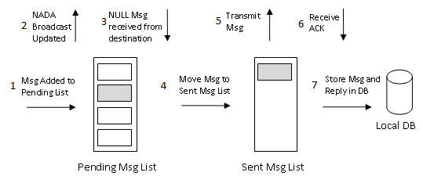
ICD Message Transmission
Message transmission triggered by user request or background processes
HNAD maintains two message lists to handle the ICD message waiting requirements
All transactions recorded to HNAD local database

Slide 37
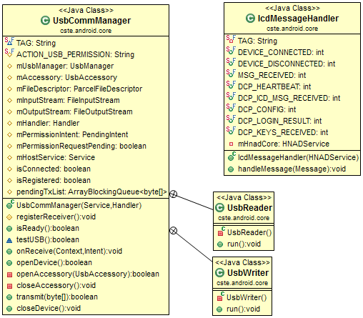
USB Process
Handles communications with an external USB to XBEE bridge device
Forwards received data to HNAD service

Slide 38
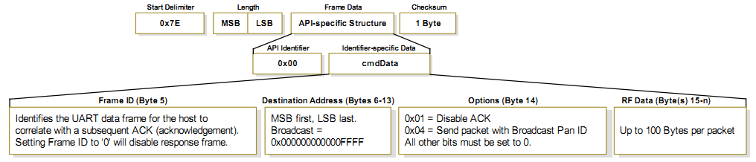
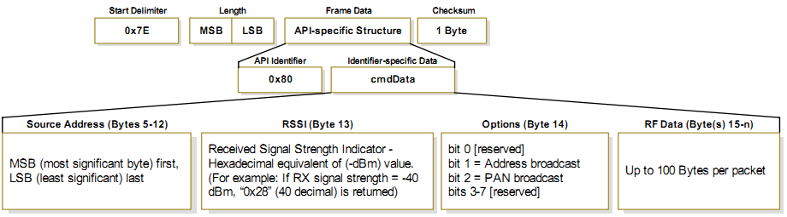
XBEE API
Generates and parses XBEE compatible frame messages

Slide 39
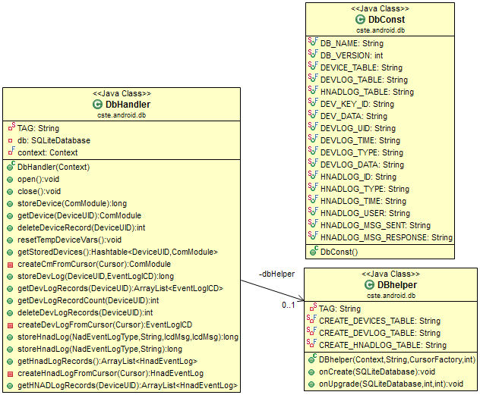
Database Handler
Stores:
HNAD logs
CSD logs
CSD device information
Implemented using a SQLite local database file

Slide 40
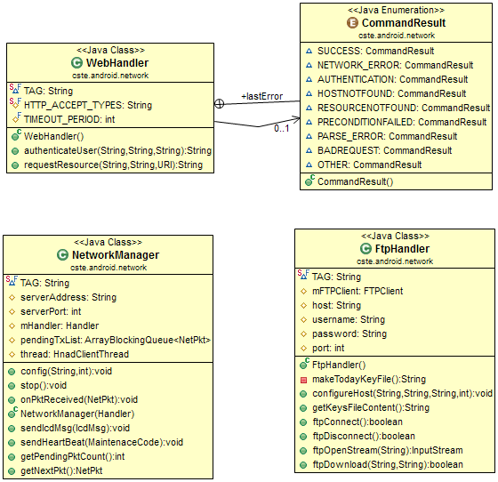
Network Communication
Objects handle communication over IP network
Components:
FTP handler
HTTP Handler
TCP client handler

Slide 41
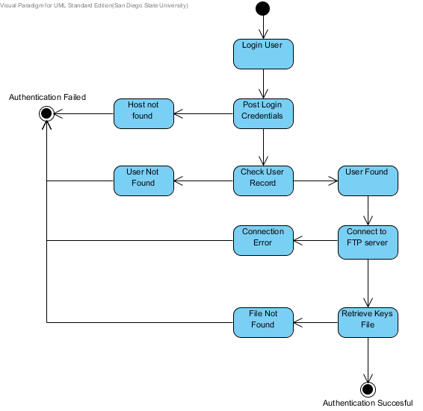
Authentication Process Handler
Separate background process launched by HNAD service
Sends user login credentials to authentication server and processes received reply

Slide 42
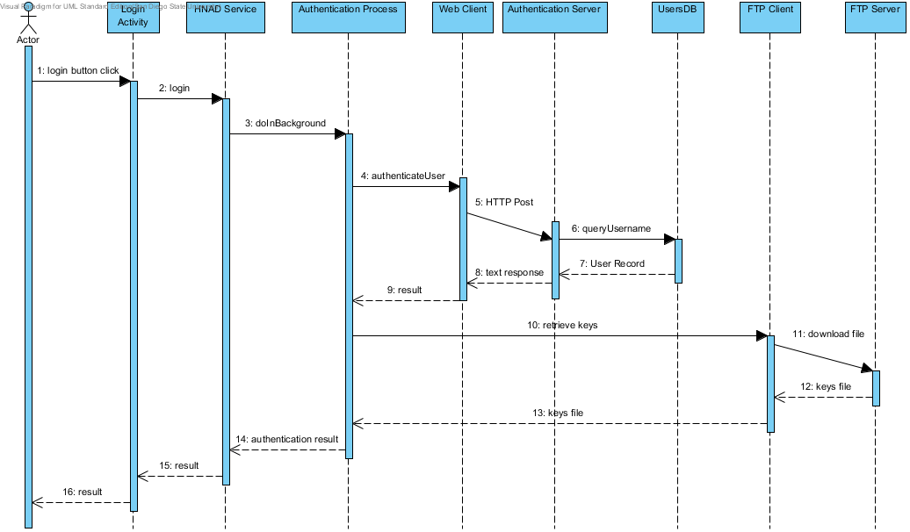
Authentication Process

Slide 43
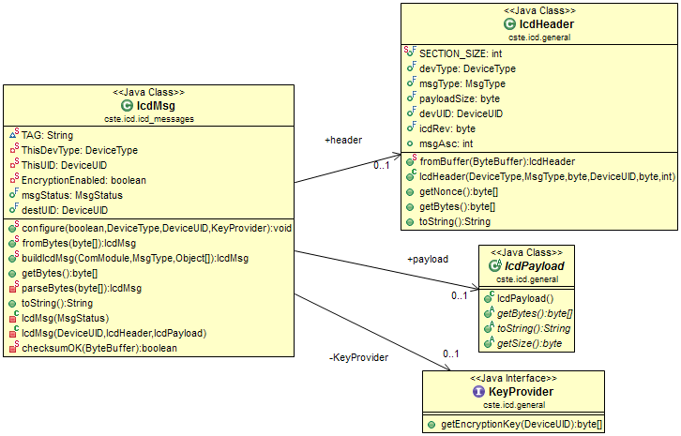
ICD Message Processing
Classes handle the process of generating and parsing received ICD messages from WPAN

Slide 44
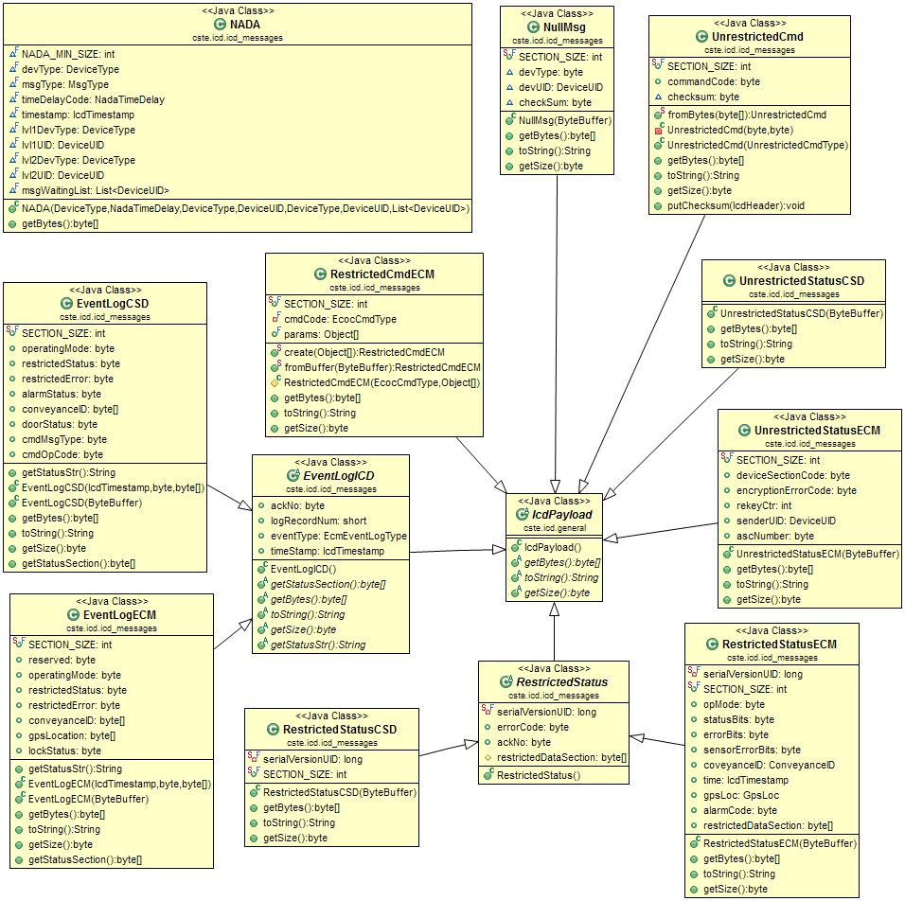
ICD Packet Payloads
Defines ICD packet payloads sent over WPAN
ICD messages organized into different payload classes
Different devices have their own payload format and content

Slide 45
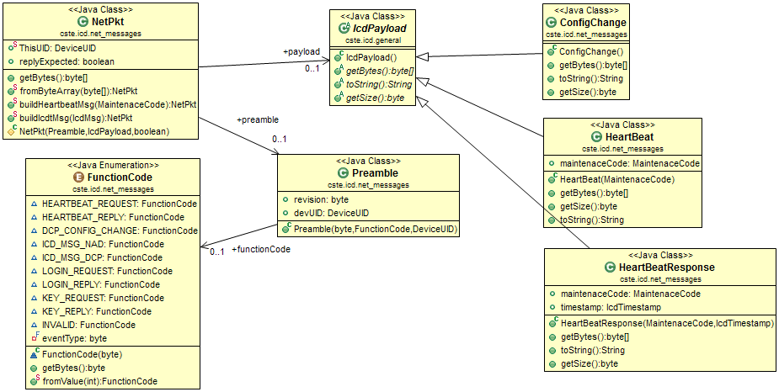
ICD IP Messages
Defines packet format for ICD messages sent over IP network
Handle packet generation and parsing

Slide 46
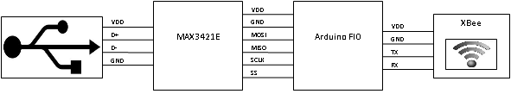
USB to XBEE Bridge
Used to relay data from HNAD unit to 802.15.4 WPAN network
Implemented using off the shelf XBEE radio module and Arduino board

Slide 47
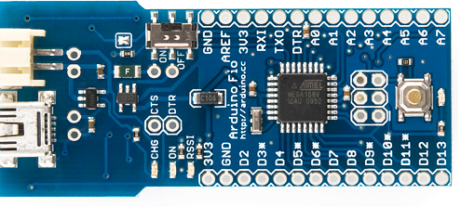
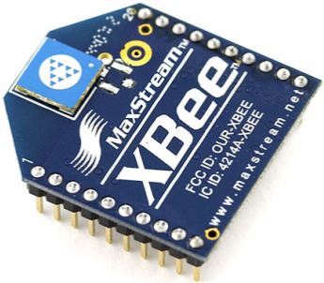
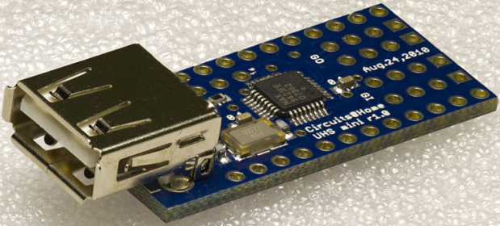
Bridge Components
Arduino board buffers and forwards data between XBEE module and USB Host controller
USB controller is compatible with Android ADK, supports Android 2.3.4 and higher

Slide 48



Authentication Web Server
Implemented using Tomcat server
Server hosts servlets to process user login and CSD encryption key assignment
Server data stored into MySQL database
Server stores assigned keys into FTP server, which HNAD then downloads keys from

Slide 49
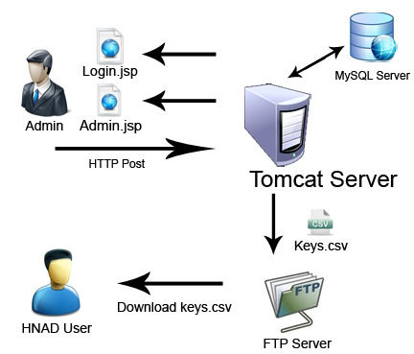
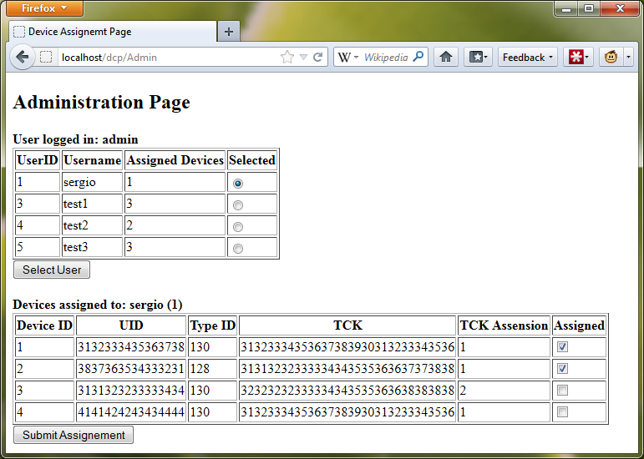
Authentication Server Operation
System admin assigns CSD keys to HNAD user
Server generates and stores keys file into FTP server
HNAD logs into authentication server and receives temporary credentials to download keys from FTP server

Slide 50

Questions

